Slide 1



Slide 2

TEAM MEMBERS
SWARNENDU ROY
ADITYA KUMAR
MONALISA SAHOO
ALEKHYA VARANASI
ROHIT RAJ
MENTOR:- RAJESH REDDY SIR

Slide 3
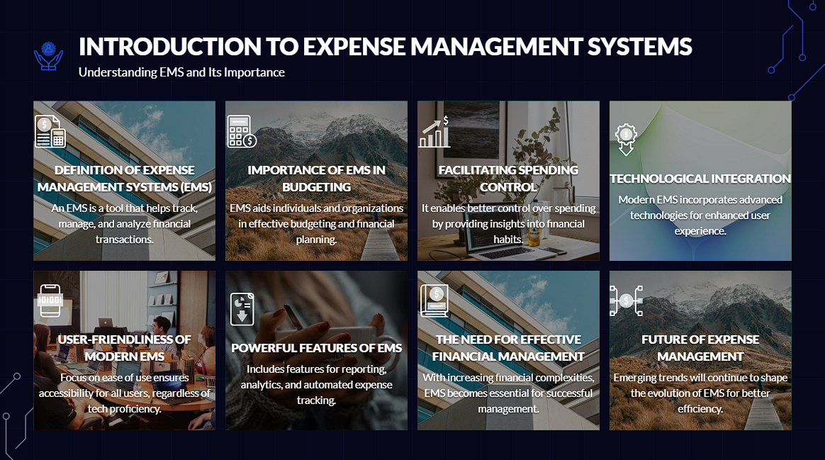
Strategies for growth
NAVIGATING THE FUTURE

Slide 4
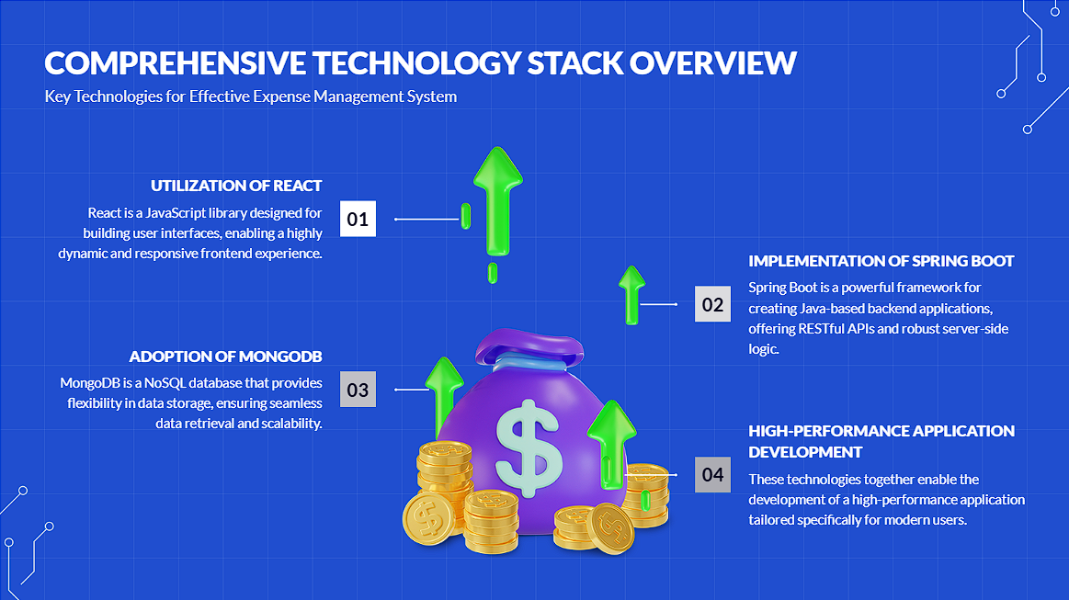
Current market analysis
We have identified important key trends that demand our attention.
Data reveals a steady increase in consumer demand for sustainable products, presenting an opportunity for our eco-friendly offerings.
Our competitors are now focusing on digital marketing strategies, suggesting a shift in consumer behavior.
Understanding these nuanced dynamics positions us to adapt and capitalize on emerging market preferences.

Slide 5
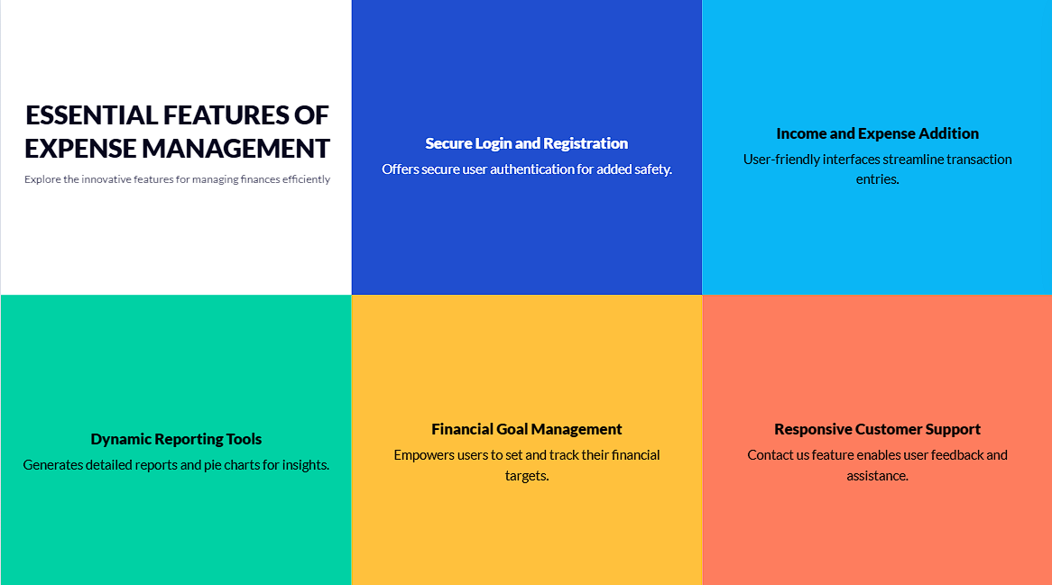
Market expansion
UNLOCKING NEW HORIZONS

Slide 6

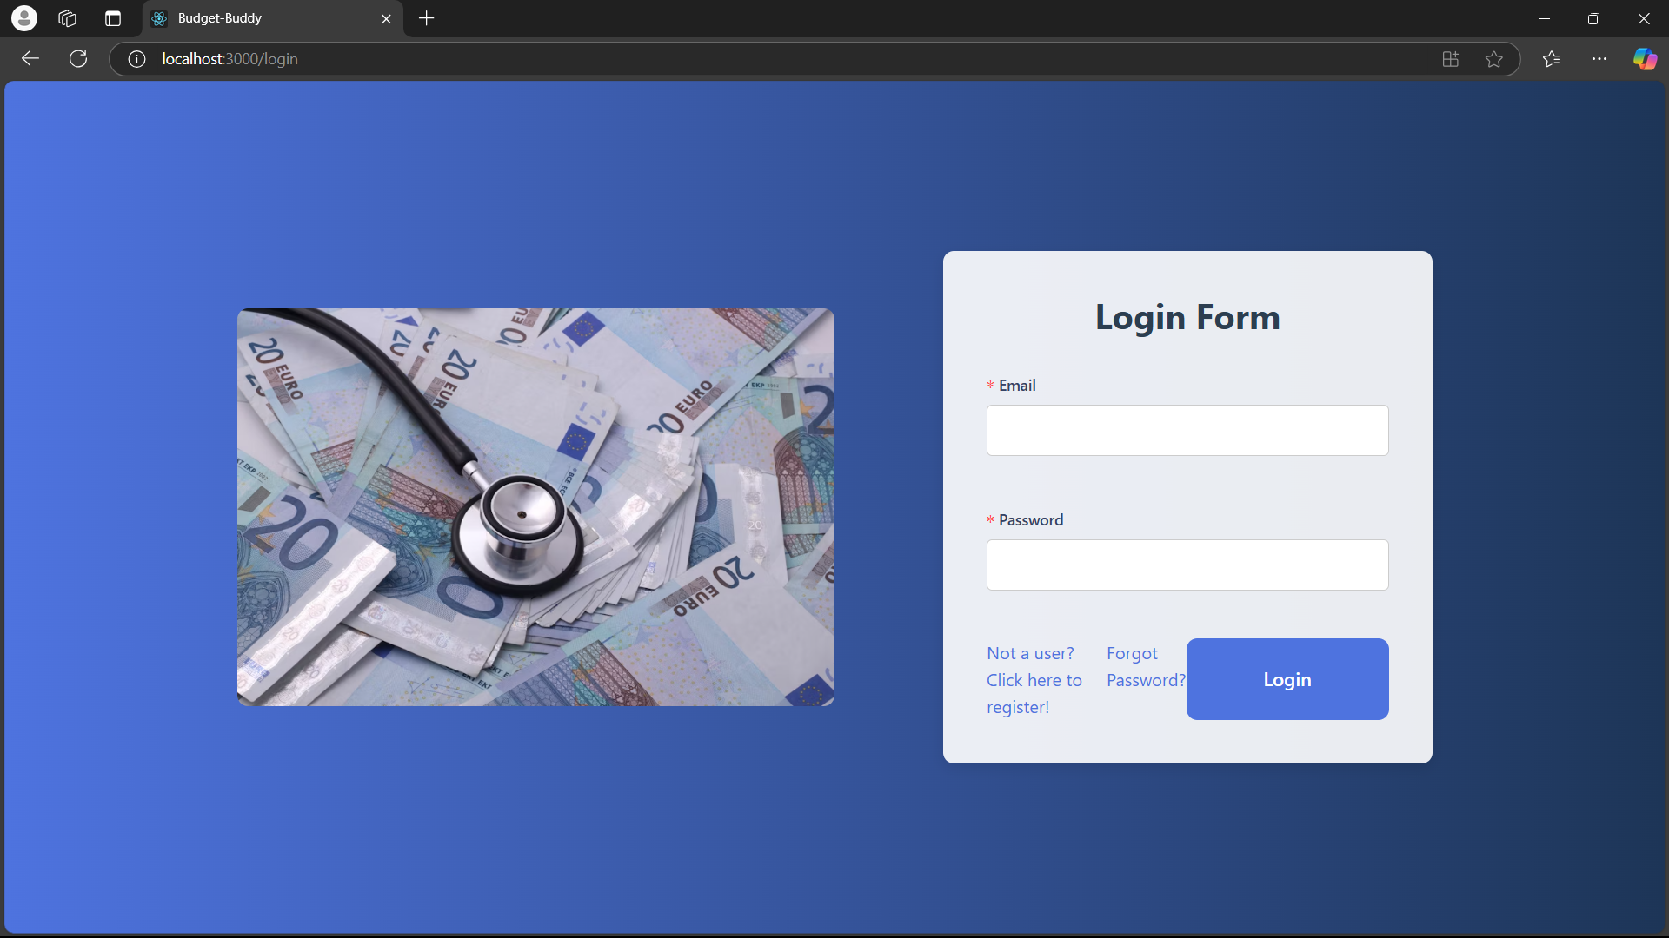
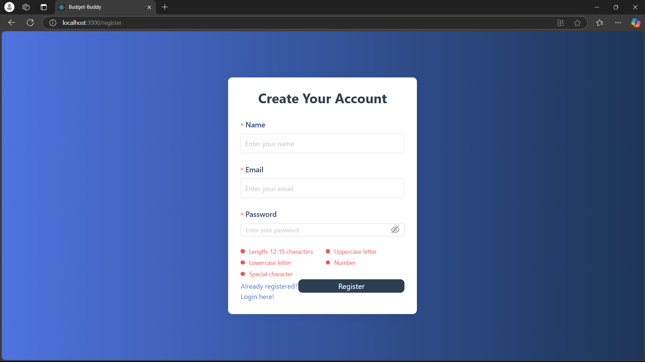
LOGIN AND REGISTRATION

Slide 7

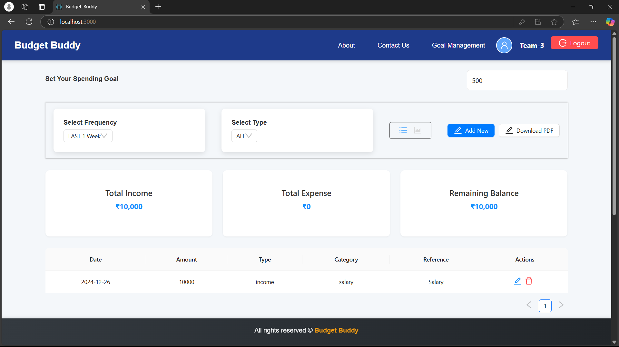
DASHBOARD

Slide 8

ADDING INCOME AND EXPENSE
ADDING INCOME AND EXPENSE

Slide 9

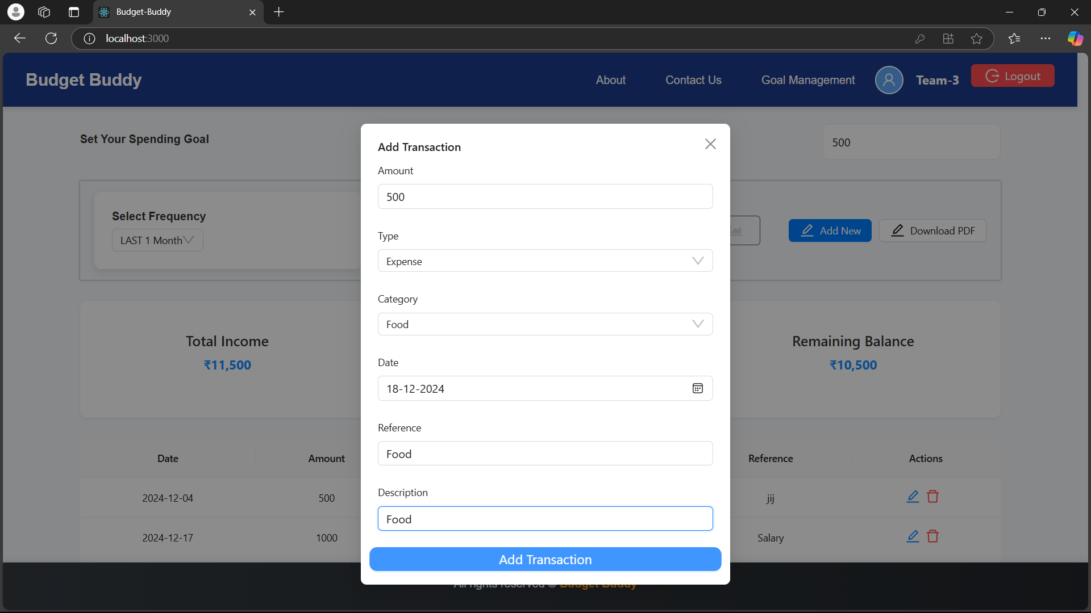
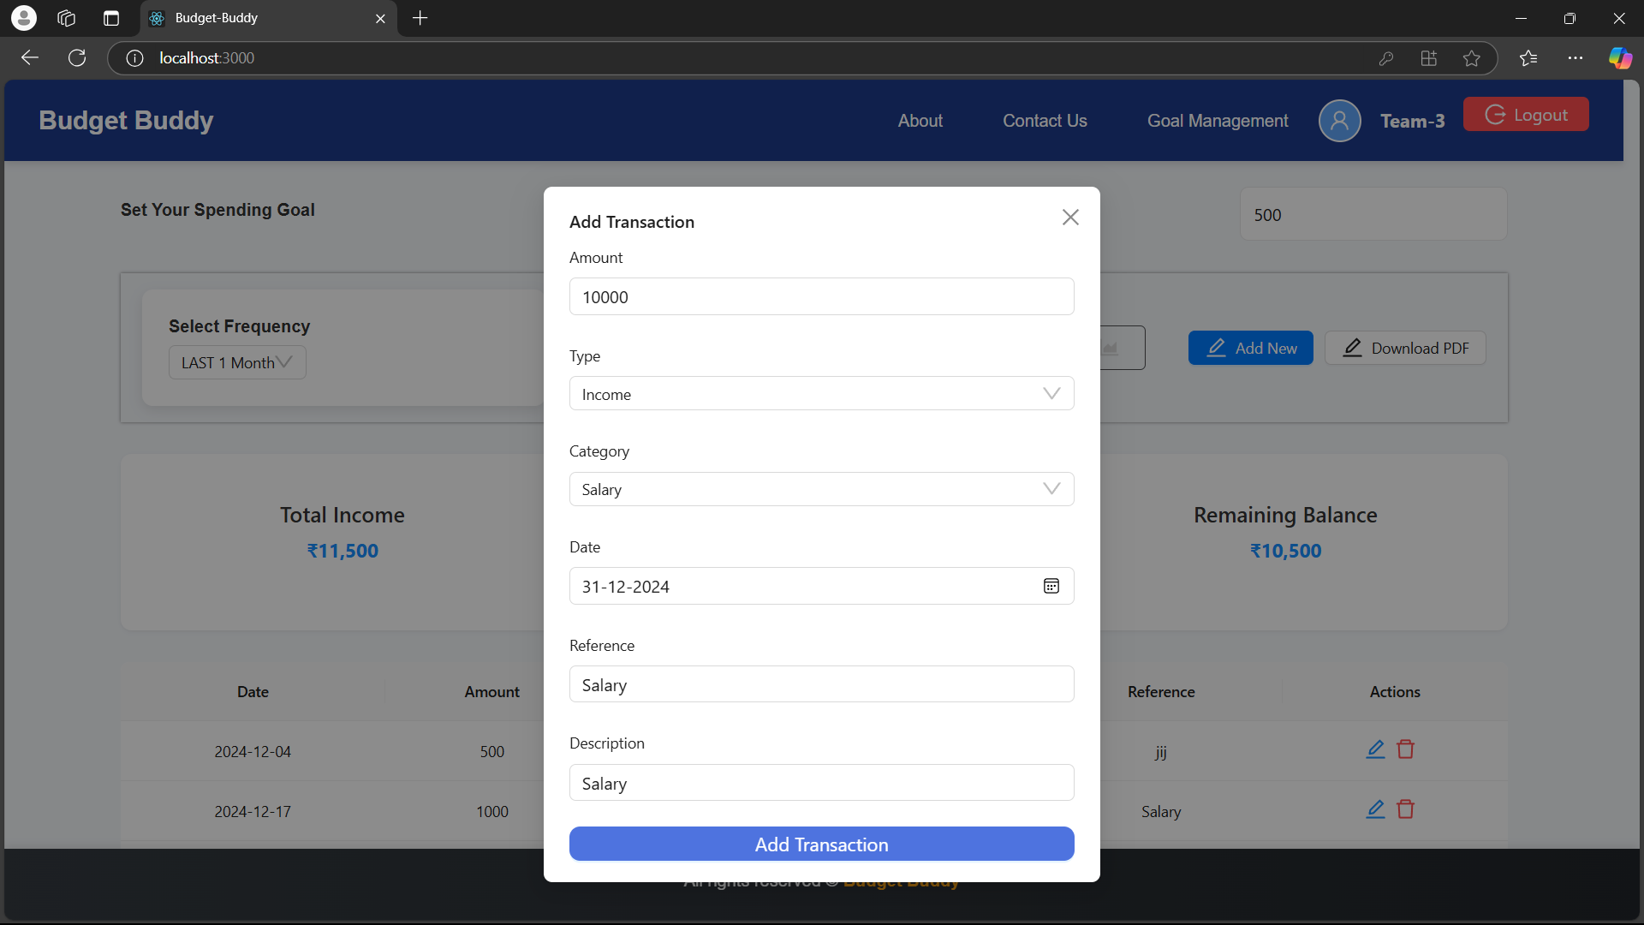
EXPENSE
INCOME

Slide 10

GRAPH AND REPORT

Slide 11
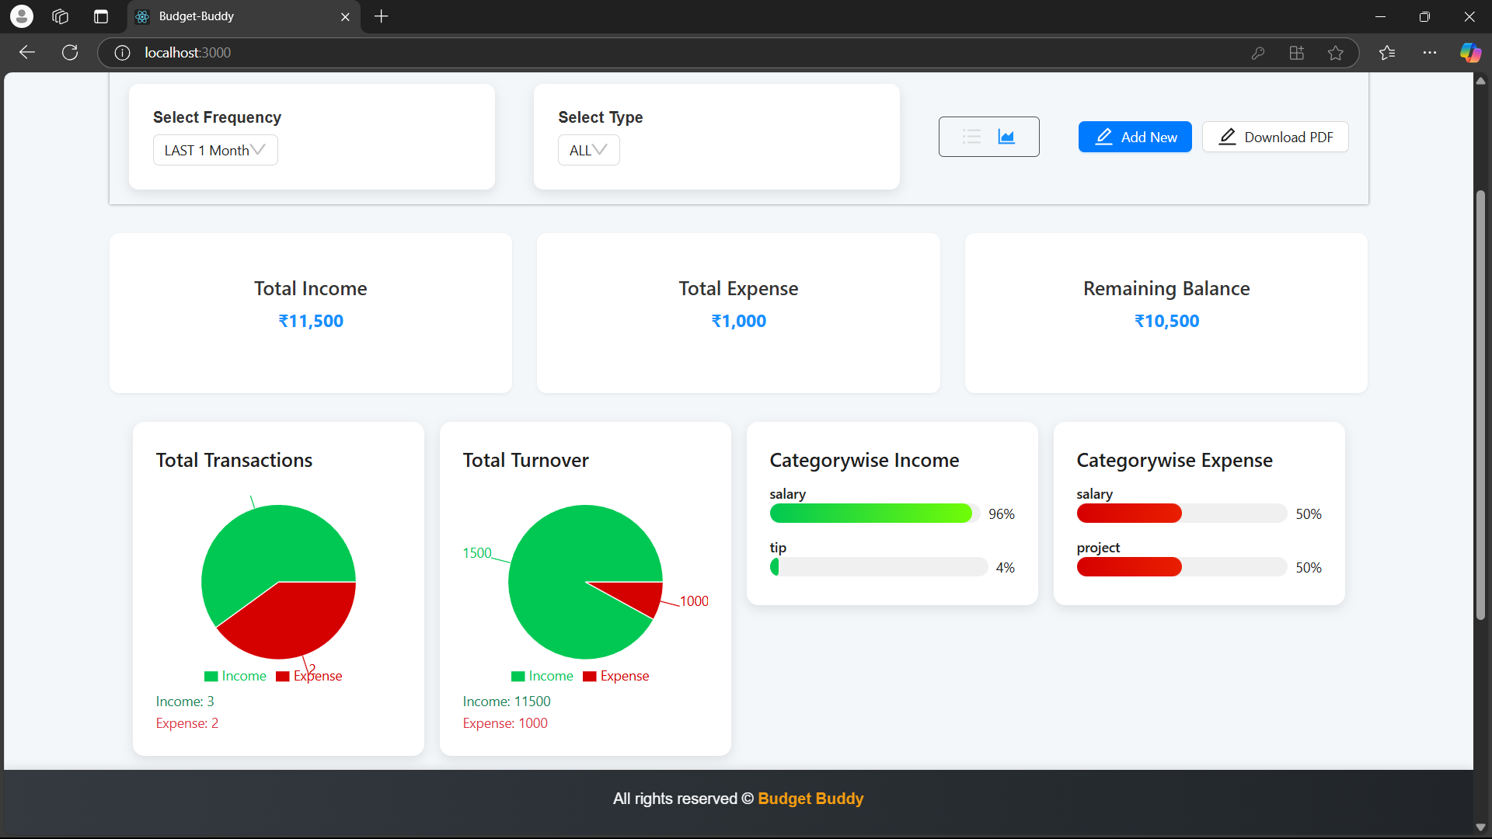

Slide 12


G AL MANAGEMENT

Slide 13
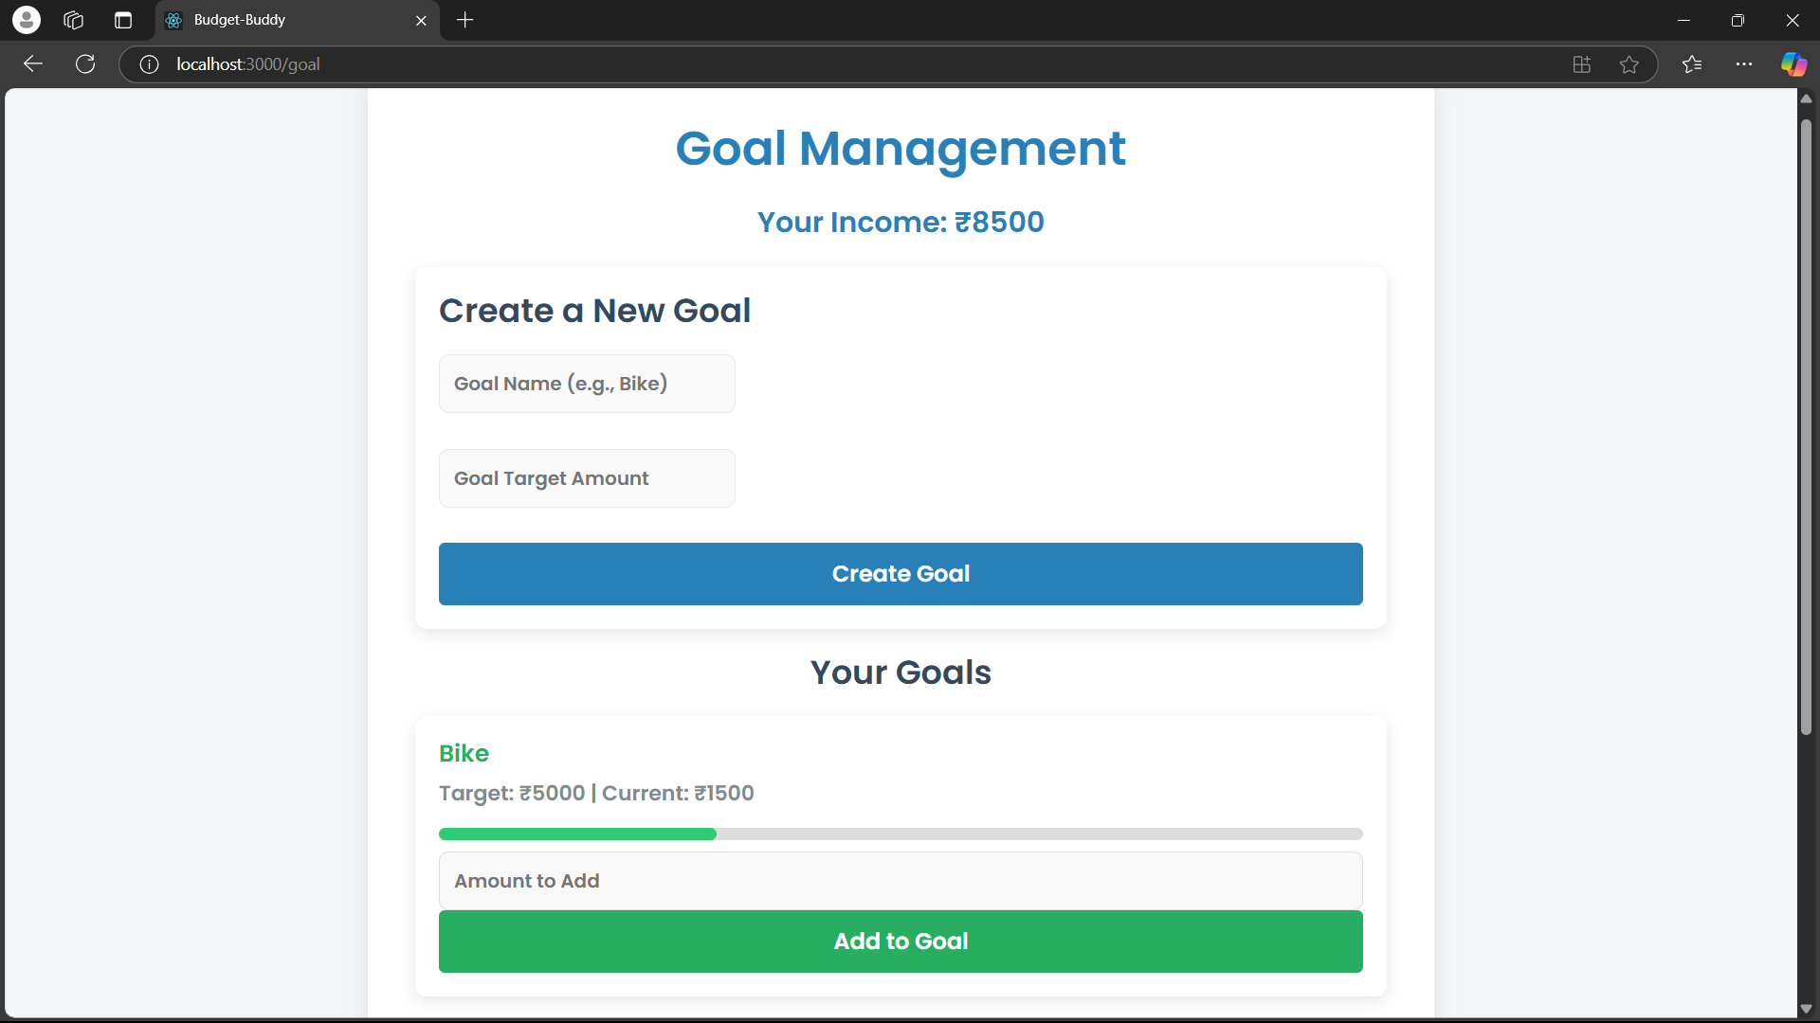
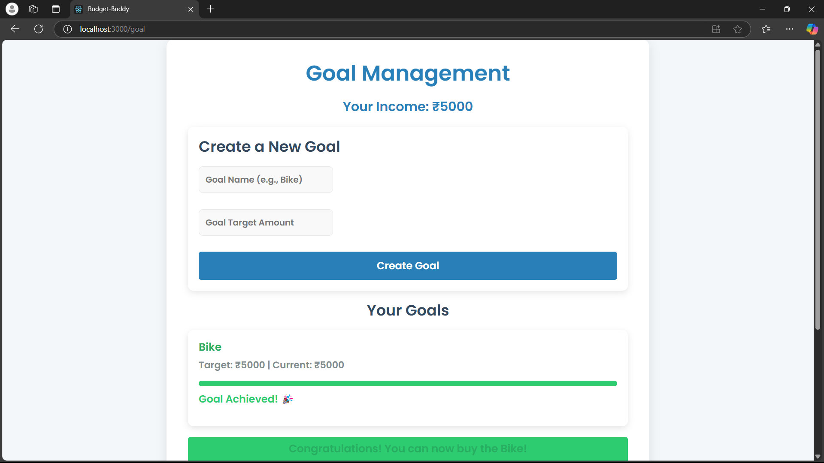
<--- Add money for the goal
Goal achieved--->

Slide 14

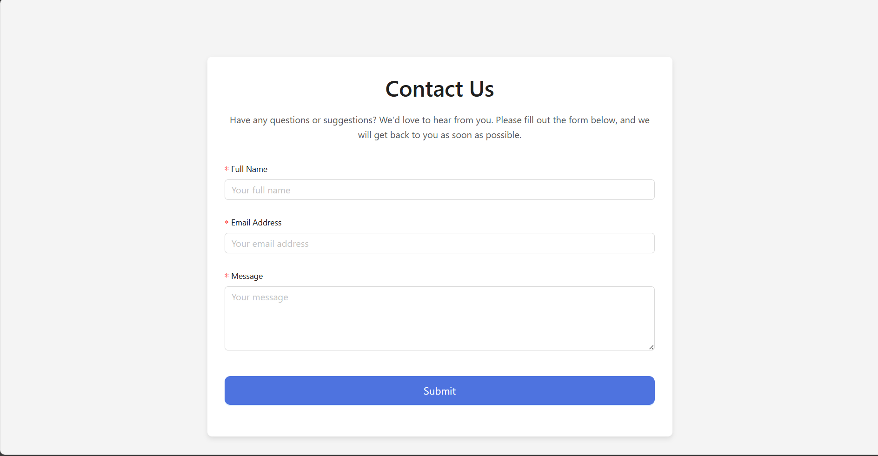

Slide 15

ACKNOWLEDGEMENT
We would like to express our sincere gratitude to Infosys Springboard for providing us with this invaluable platform to learn, innovate, and showcase our skills. A special thanks to our mentor, Rajesh Reddy Sir, for his unwavering guidance, support, and insights throughout the development of this project. His mentorship has been instrumental in refining our skills and delivering this solution. Thank you for believing in us and inspiring us to excel.

Slide 16

CONCLUSION
The BUDGET BUDDY is a user-friendly and secure solution for managing personal finances, featuring robust tools for tracking, analysis, and personalization. This project demonstrates our technical expertise and ability to deliver impactful, real-world applications.

Slide 17

THANK YOU

